Slide 1
FIT1055: IT professional practice and Ethics
Week 2: Effective Communications and Oral Presentations
in the context of IT Professional Practice

Slide 2
What You Will Learn This Week
By the end of Week 2, you will be able to:
Comprehend the theory of communication and its relevance to computing professionals
Recognize and apply intrapersonal and interpersonal communication techniques (assertiveness, active listening, questioning, feedback)
Use the Minto Pyramid Principle as a framework for structuring effective oral presentations
FIT1055: IT Professional Practice and Ethics | Week 2

Slide 3
Part 1: Theory of Communication
Speech Acts · Common Ground · Relevance to IT Professionals
FIT1055: IT Professional Practice and Ethics | Week 2

Slide 4
Speech Act Theory by J.L Austin and John Searle
📖 Key Insight: When we speak, we simultaneously DO something. Every utterance has a purpose.
Speech acts are the speaker’s utterances that convey meaning and make listeners do specific things (Austin, 1962).
According to Austin (1962), when saying a performative utterance, a speaker is simultaneously doing something.
Why does this matter for IT professionals?
Every email, meeting, and presentation is a speech act
Understanding intent helps you communicate more effectively with colleagues and clients
FIT1055: IT Professional Practice and Ethics | Week 2

Slide 5
Performative Utterance
Utterances that are used to perform: requests, warnings, invitations, promises, predictions etcs.
Example:
“I am hungry.” expresses hunger, request for something to eat
That is why communication is important (verbal or non-verbal (e.g., writing and gestures) because it is the way people express what they need, want, and need to get things done
Language is central to everything – it makes us uniquely human
FIT1055: IT Professional Practice and Ethics | Week 2

Slide 6
Speech Act in Everyday Utterances
"You're fired!“
Expresses both the employment status of the individual in question, as well as the action by which said person's employment is ended.
"We ask that you extinguish your cigarettes at this time, and bring your tray tables and seatbacks to an upright position."
Describes the requirements of the current location, such as an airplane, while also issuing the command to stop smoking and to sit up straight.
"Would it be too much trouble for me to ask you to hand me that wrench?" functions t
Simultaneously ask two questions. The first is to ask the listener if they are capable of passing the wrench, while the second is an actual request.
FIT1055: IT Professional Practice and Ethics | Week 2

Slide 7
🎭 Quick Activity — Identify the Speech Act
3 minutes — analyse each utterance with a partner
1
“You're fired!” — What is the illocutionary act? What effect does it have?
2
“Could you send me that report by end of day?” — Is this a question or a request?
3
Think of a message you sent this week — what was the speech act behind it?
FIT1055: IT Professional Practice and Ethics | Week 2

Slide 8
Common Ground — Herbert H. Clark (1996)
Goal of communication: achieving mutual understanding between speaker and listener
What is Grounding?
Listener Must...
01
Ensuring both speaker and listener reach shared understanding of what was said and meant.
02
Notice · Hear · Understand what was said · Understand what was MEANT
Common Ground Accumulates
Why Real Conversation is Messy
03
Shared history, cultural context, and interaction history all contribute to common ground over time.
04
Incomplete sentences, pauses, overlapping turns, unintelligible utterances — all normal!
For IT Professionals
05
Building common ground with clients and teams reduces misunderstandings and project failures.
FIT1055: IT Professional Practice and Ethics | Week 2

Slide 9
What is Professional Communication?
Communications that occur with your colleagues within an organization, professional society or organization and colleagues external to your organization
Communication is defined as a:
Two-way process of reaching mutual understanding, in which participants not only exchange (encode- decode) information, news, ideas and feelings but also create and share meaning.
In general, communication is a means of connecting people or places.
It can be categorized into verbal and non-verbal (includes gestures and writing)
01
05
FIT1055: IT Professional Practice and Ethics | Week 2

Slide 10



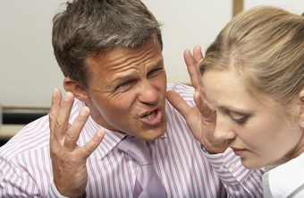
Situations where you will apply professional communication
Speaking with your boss
Being in a meeting
01
02
Discussing with your colleagues
Managing conflict
03
04
FIT1055: IT Professional Practice and Ethics | Week 2

Slide 11
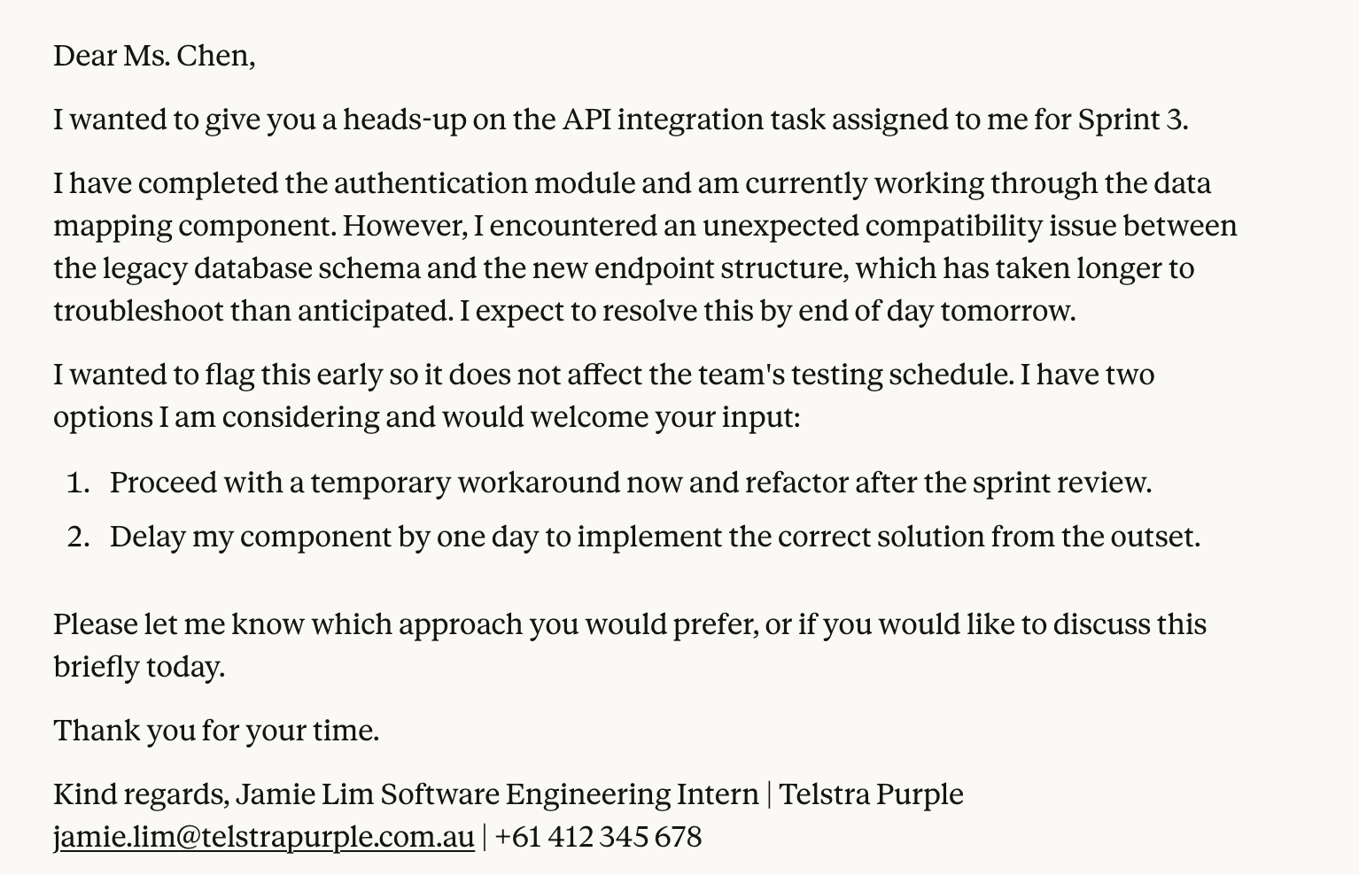
Situations where you will apply professional communication
Professional emails to colleagues, boss, and clients
01
FIT1055: IT Professional Practice and Ethics | Week 2

Slide 12
Part 2: Professional Communication Skills
Intrapersonal · Interpersonal · Effective Techniques
FIT1055: IT Professional Practice and Ethics | Week 2

Slide 13
Intrapersonal vs Interpersonal Skills for IT Professionals
Intrapersonal Skill
Interpersonal Skill
Why It Matters
In Action
Communication with oneself
Communication with others
For your IT career
Real examples
Self-talk, reflection, internal motivation and self-regulation
Verbal and non-verbal exchanges with colleagues, clients and teams
Strong communication skills lead to better team outcomes and client relationships
Team standup meeting · Client requirements gathering · Code review feedback
Self-discipline · Self-awareness · Open-mindedness · Patience
Assertiveness · Active Listening · Questioning · Feedback
Builds trust · Reduces conflict · Increases productivity
All require BOTH intra and interpersonal skills
💡 Knowing your own strengths and limits (intrapersonal) helps you communicate your ideas with confidence (interpersonal)
FIT1055: IT Professional Practice and Ethics | Week 2

Slide 14
Part 2.1: Types of Interpersonal skills
With non-graded quiz to test your understanding
FIT1055: IT Professional Practice and Ethics | Week 2

Slide 15
⚡ Assertiveness Techniques — IT Workplace Context
Assertiveness = getting desired outcomes without contravening others' rights (Eunson, 2012)
The Techniques:
Workable Compromise · Fogging · Broken Record · Forcing a Choice · Threat · Ask for Specific
FIT1055: IT Professional Practice and Ethics | Week 2

Slide 16
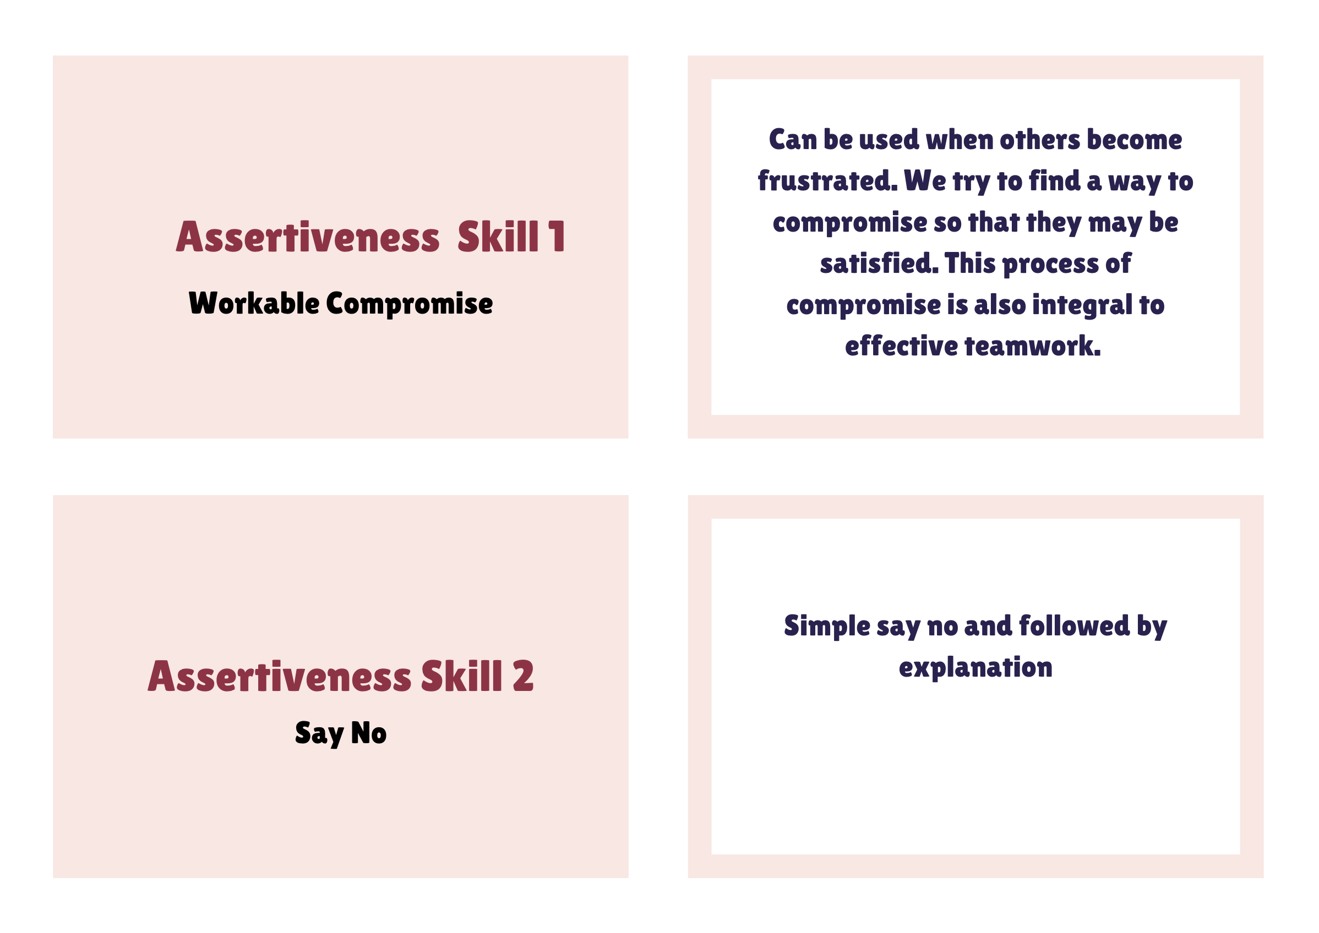
⚡ Flashcards
FIT1055: IT Professional Practice and Ethics | Week 2

Slide 17
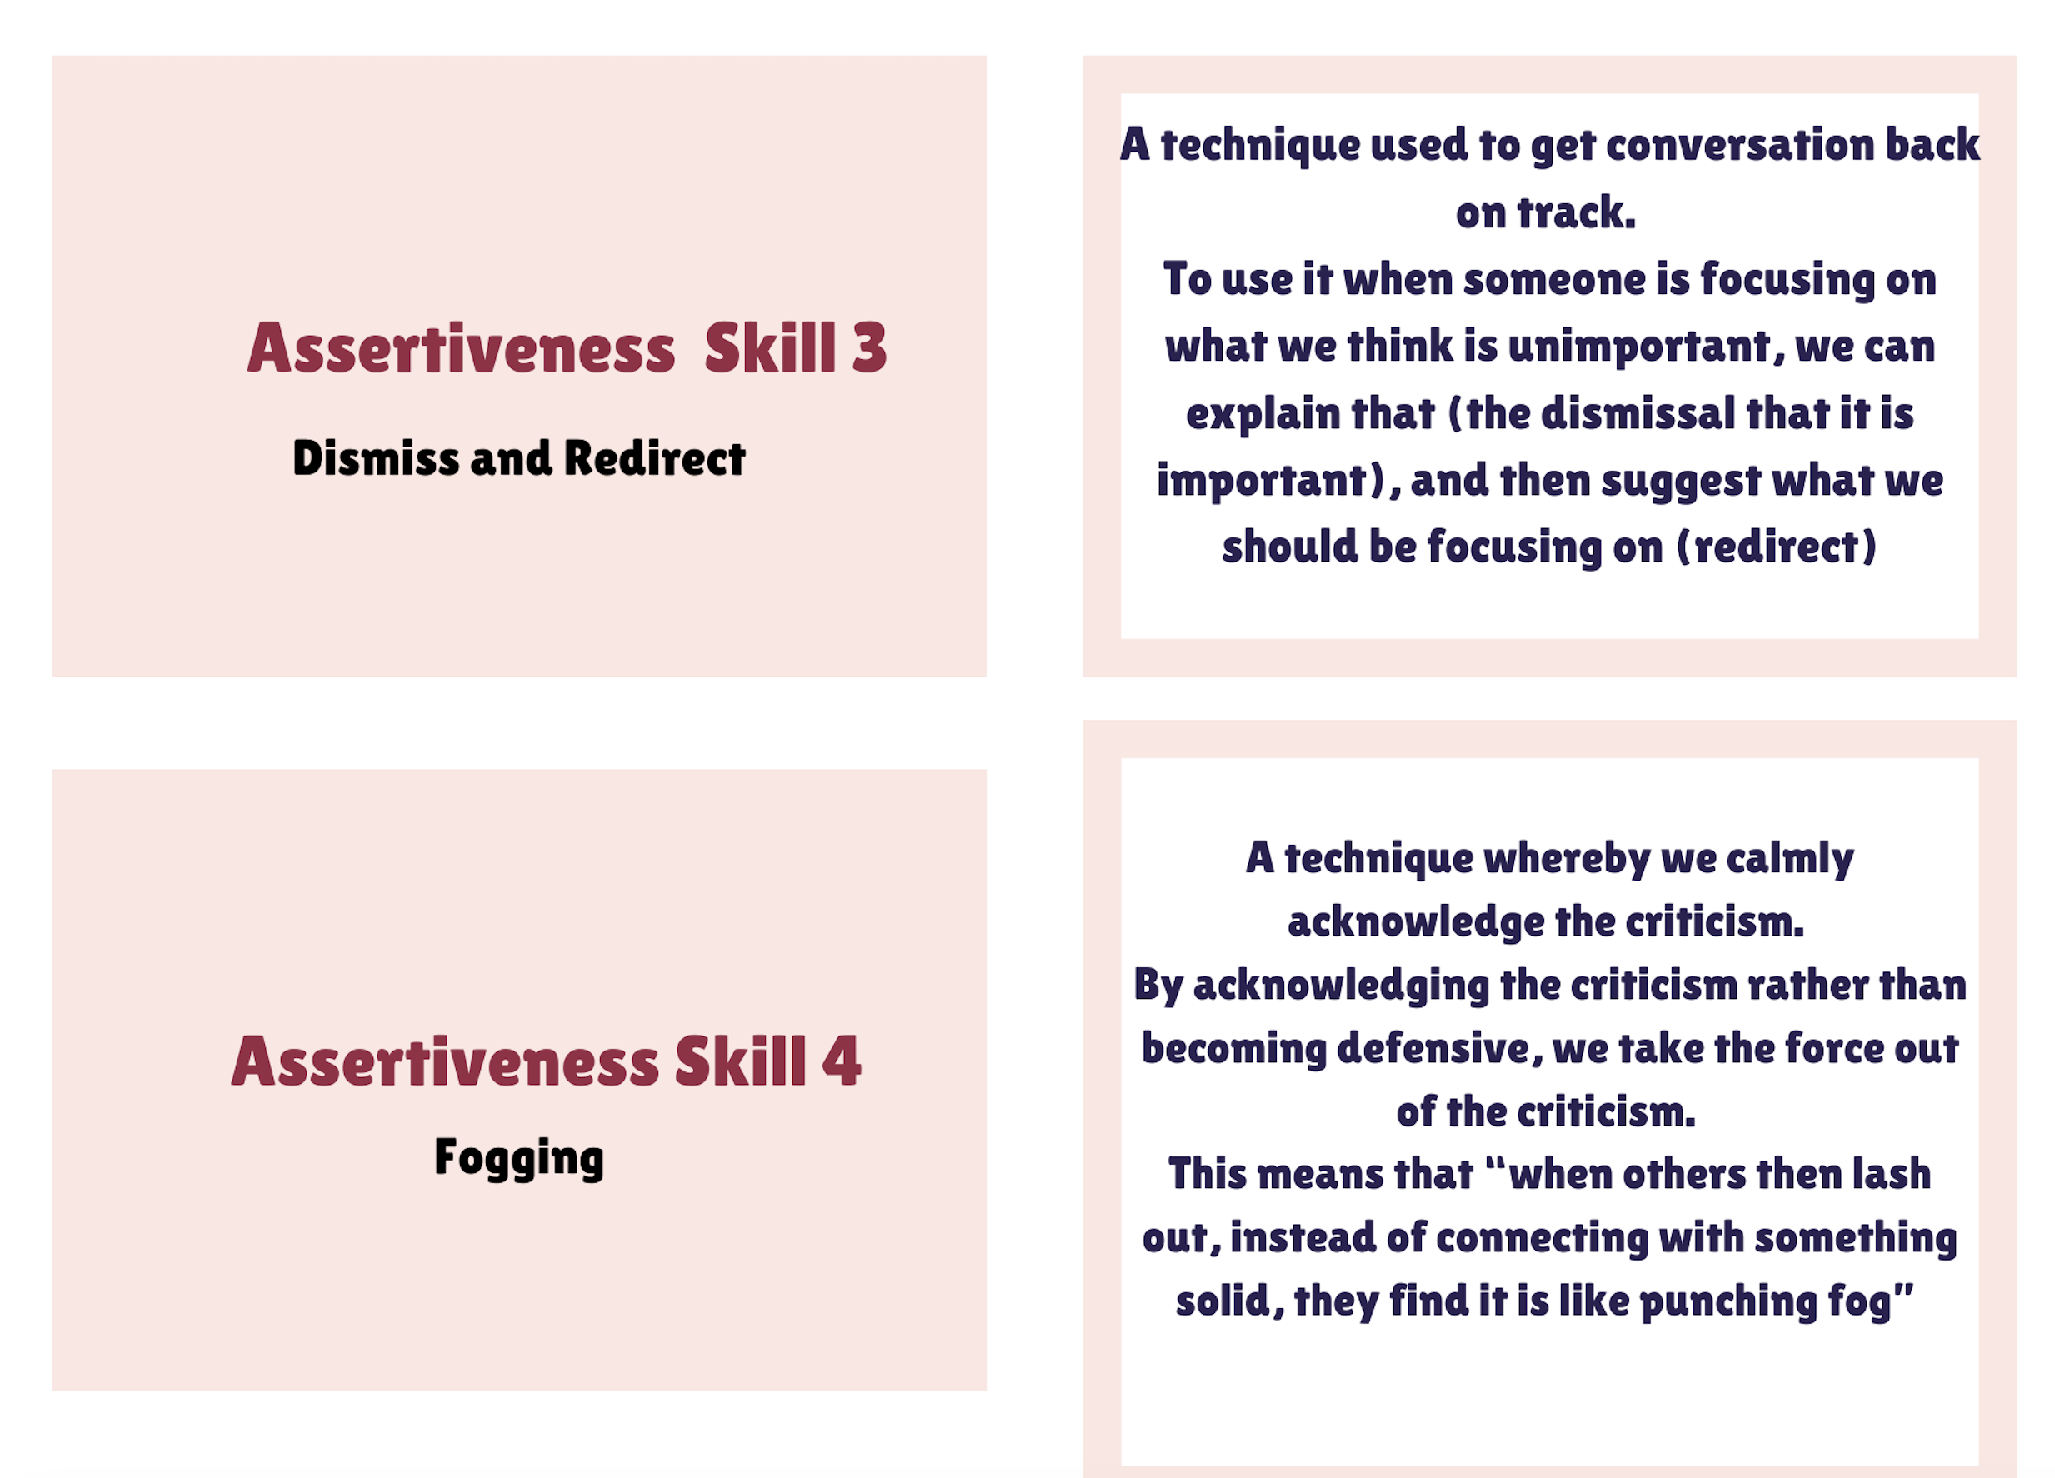
⚡ Flashcards
FIT1055: IT Professional Practice and Ethics | Week 2

Slide 18
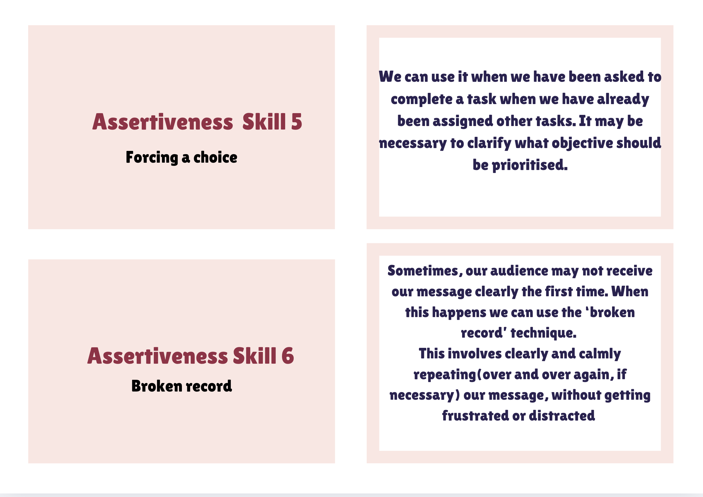
⚡ Flashcards
FIT1055: IT Professional Practice and Ethics | Week 2

Slide 19
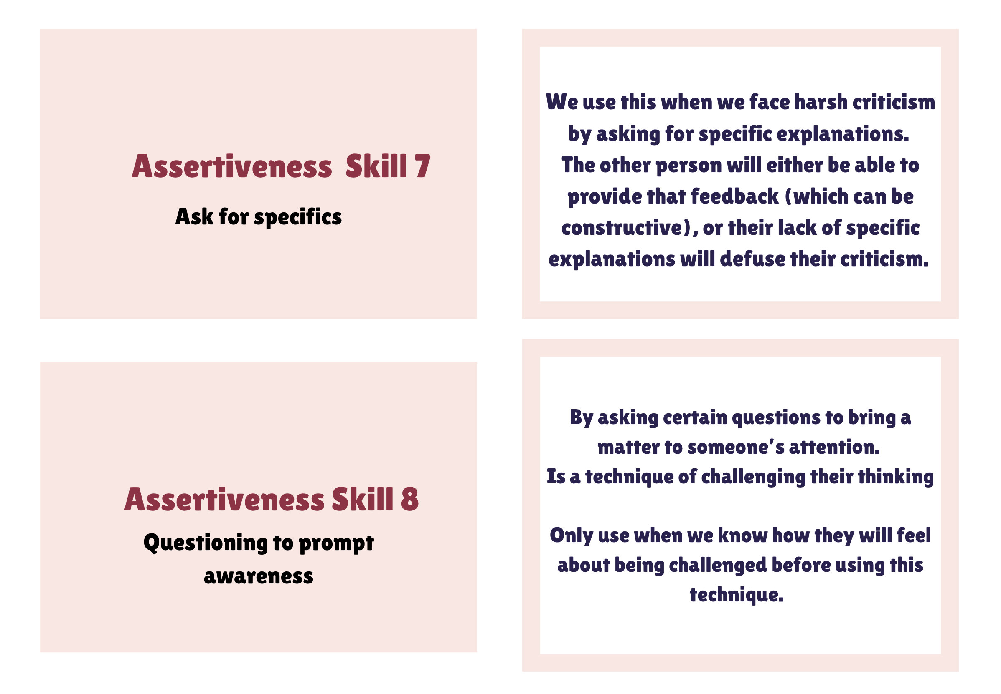
⚡ Flashcards
FIT1055: IT Professional Practice and Ethics | Week 2

Slide 20
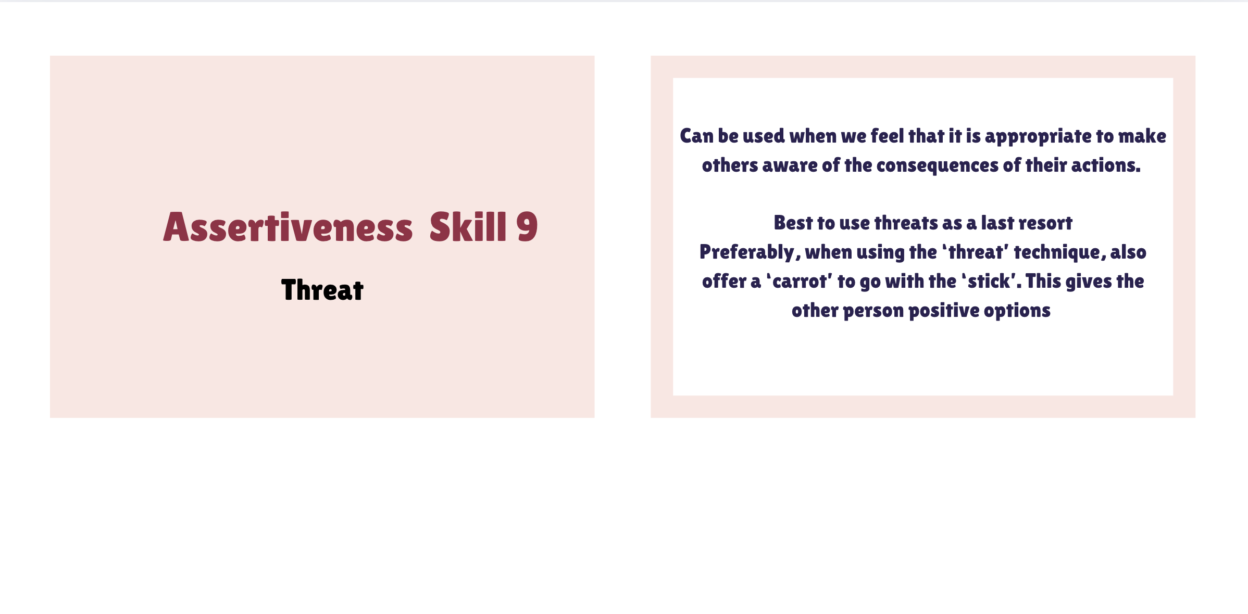
⚡ Flashcards
FIT1055: IT Professional Practice and Ethics | Week 2

Slide 21
🎭 Role Play — The Workplace Scenario
5 minutes in pairs — one person plays Lin, the other plays Kamil
1
Scenario: Kamil asks Lin to audit all equipment by end of month, but she is already finalising a major report. How should she respond?
2
Lin's goal: Use the Forcing a Choice assertiveness technique to manage the conflict
3
Debrief: What technique did you use? How did it feel? What would you do differently?
FIT1055: IT Professional Practice and Ethics | Week 2

Slide 22
Quiz 1: Test your authentic learning in applying effective communication skills techniques
Before we begin, please do the following
1
Read through the flashcard for 5-10 minutes and the accompanied notes on Moodle
2
Attempt the quiz on this link: https://quizizz.com/join?gc=38003928
FIT1055: IT Professional Practice and Ethics | Week 2

Slide 23
⚡ Listening and Active Listening Technique
Good listening skills provides contexts for common ground
Used the technique well, gets you to:
Understand the full details of a situation - Opportunity to learn and develop - Let others work through and resolve their own issues -Makes others more likely to listen to you
FIT1055: IT Professional Practice and Ethics | Week 2

Slide 24
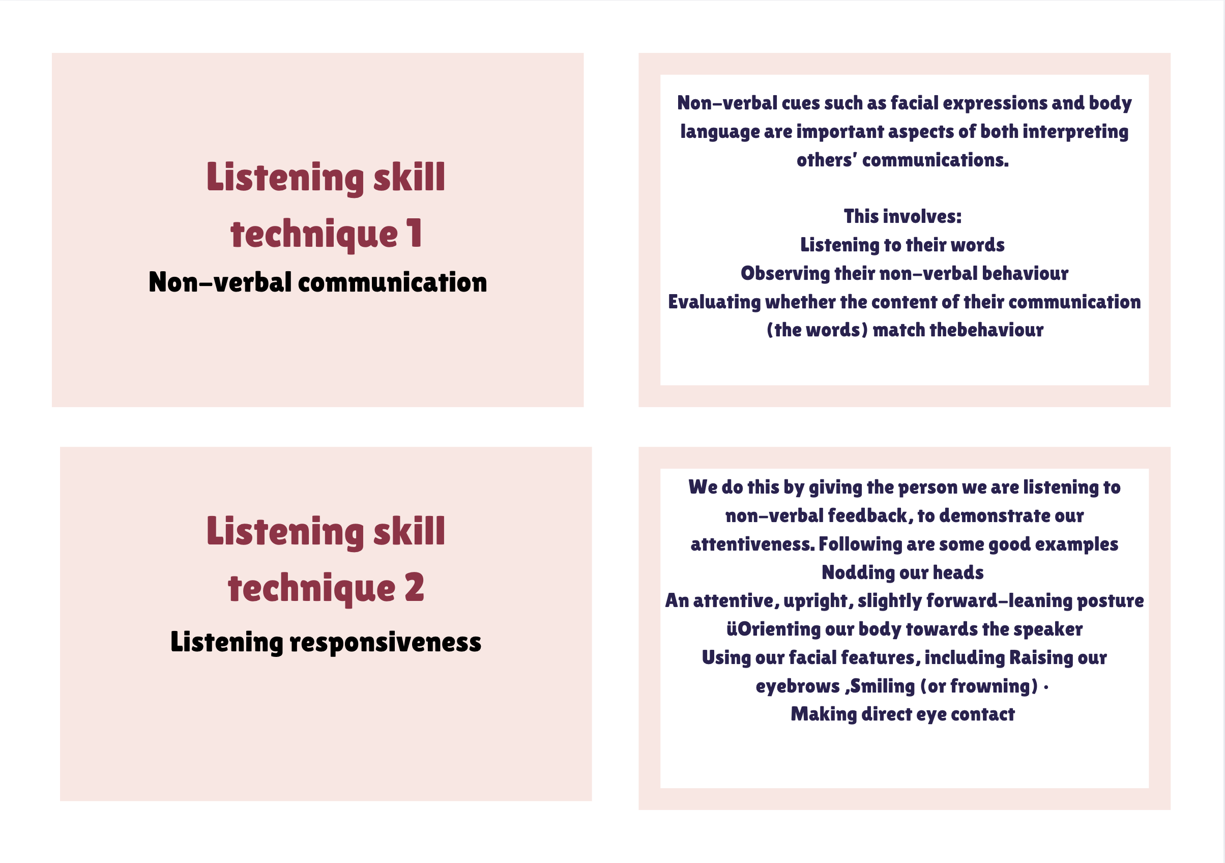
⚡ Flashcards
FIT1055: IT Professional Practice and Ethics | Week 2

Slide 25
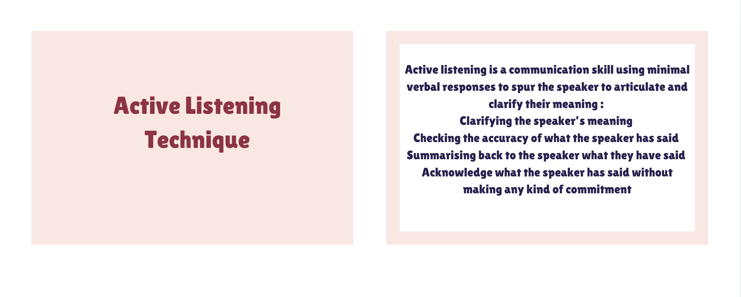
⚡ Flashcards
FIT1055: IT Professional Practice and Ethics | Week 2

Slide 26
⚡ Flashcards
FIT1055: IT Professional Practice and Ethics | Week 2

Slide 27
⚡ Questioning Technique
Asking questions is the key to understanding situations around us
Being curious and inquisitive is to be encouraged by questioning
Famously, Albert Einstein stated that. ‘The important thing is not to stop questioning. Curiosity has its own reason for existing.’
FIT1055: IT Professional Practice and Ethics | Week 2

Slide 28
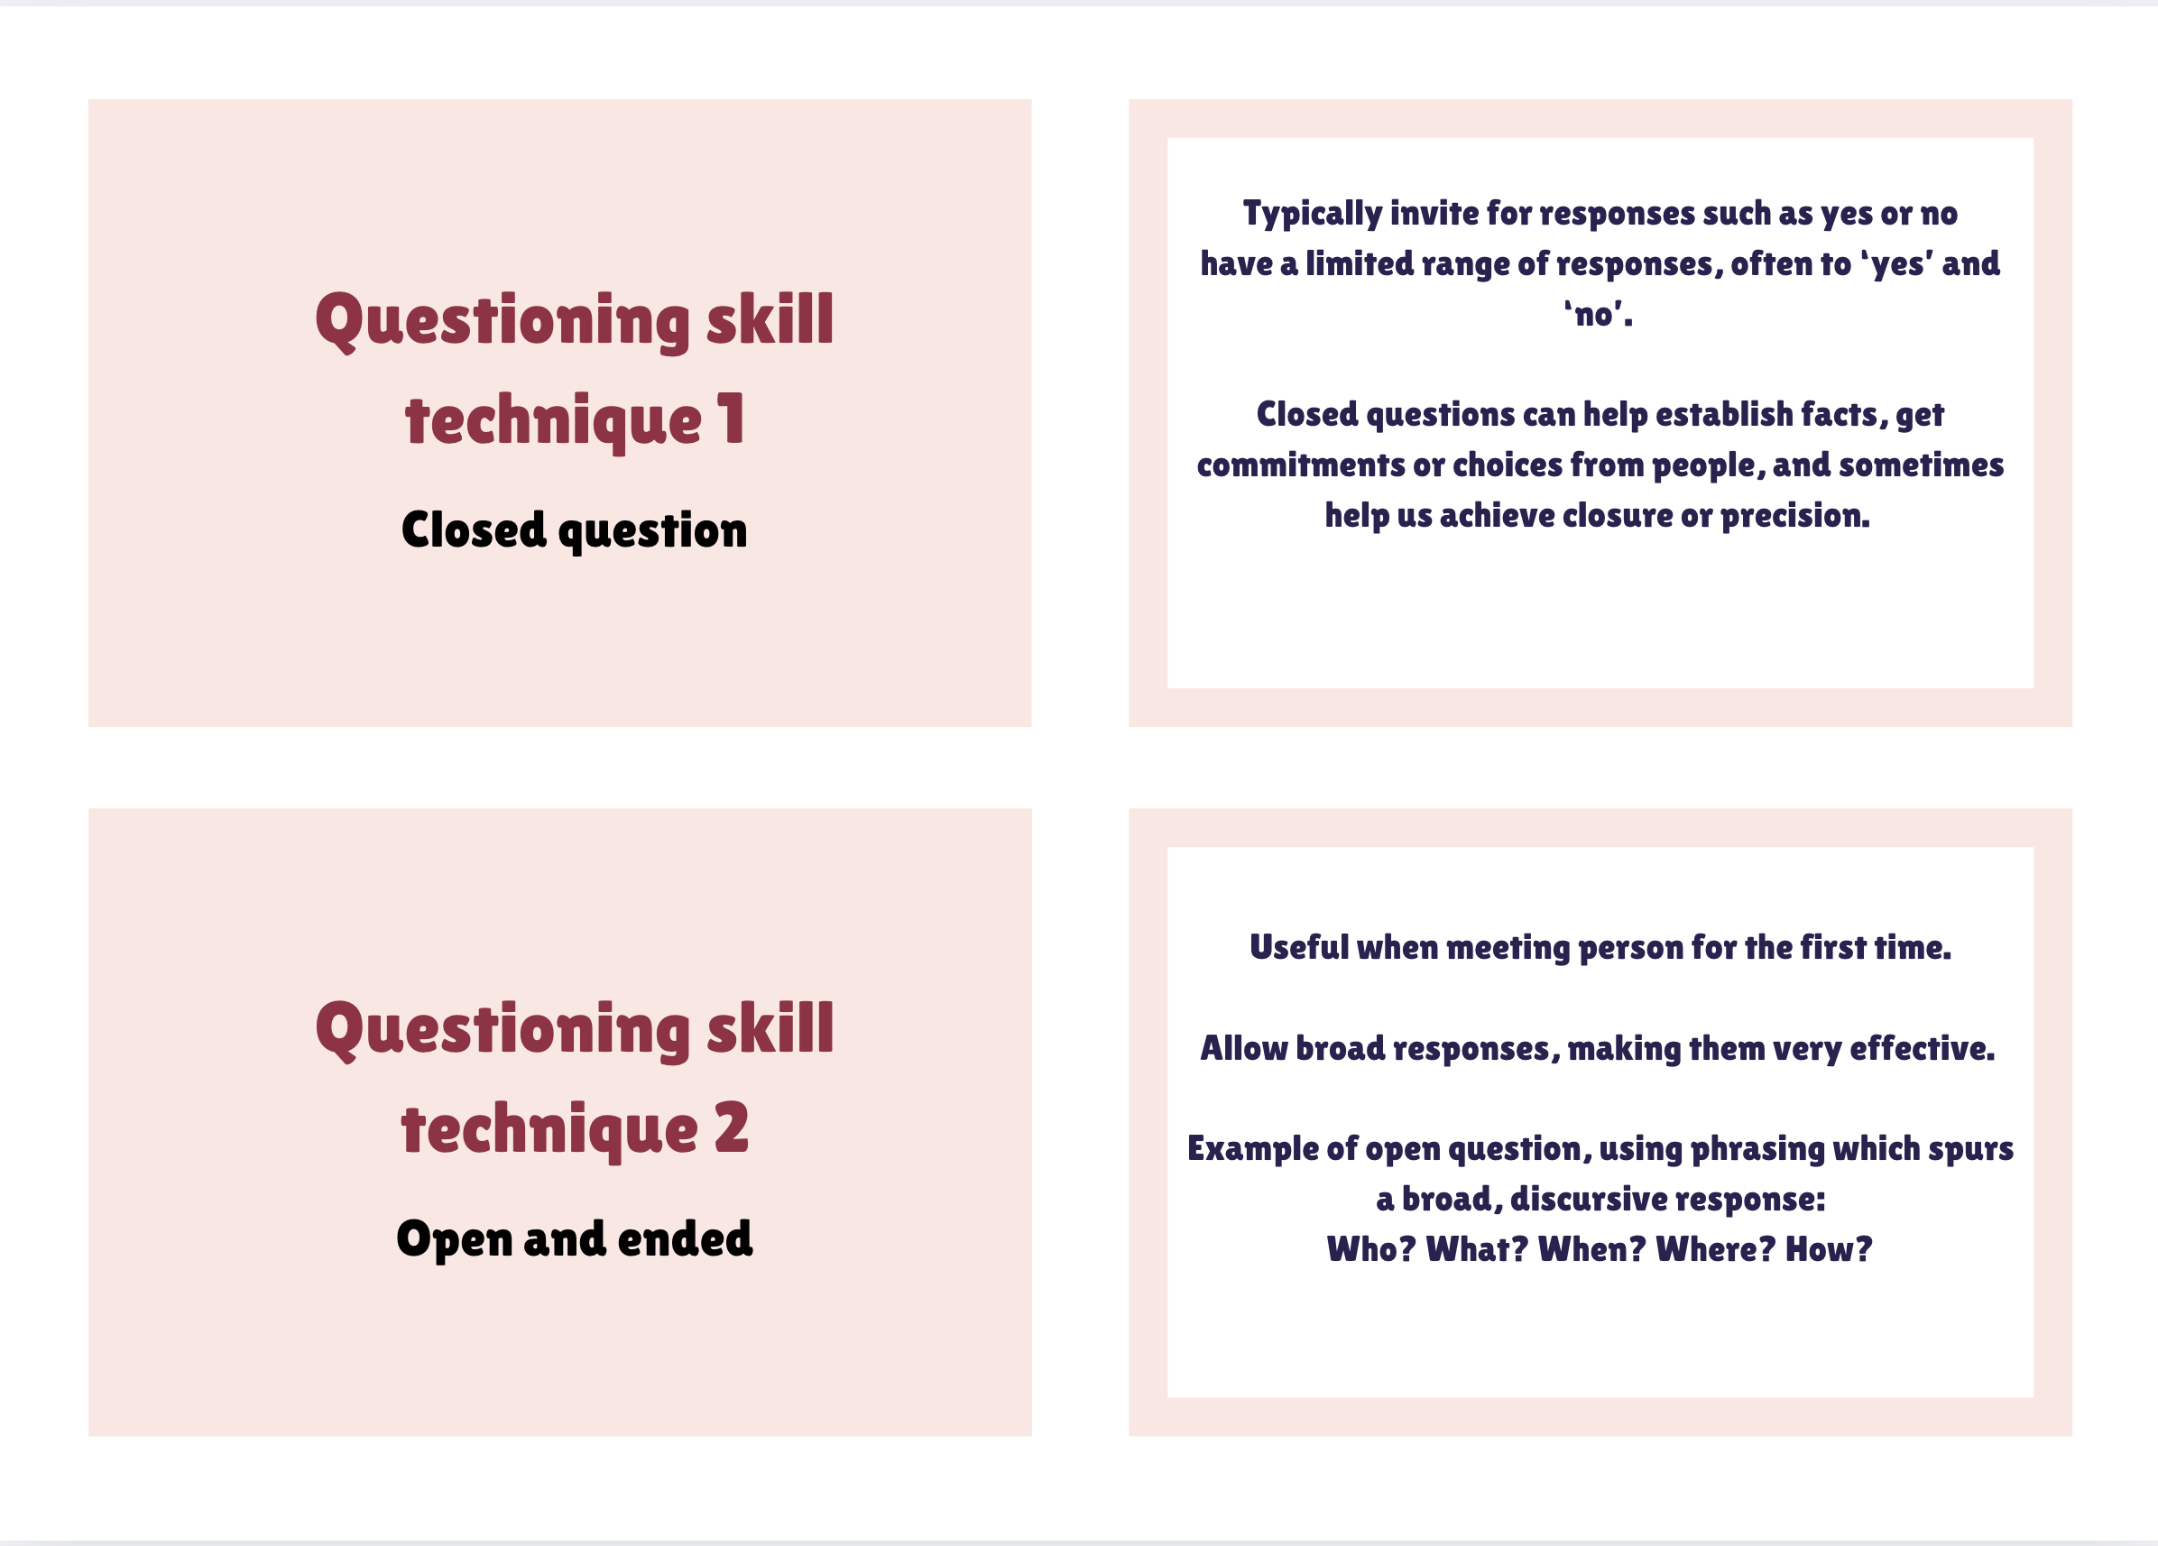
⚡ Flashcards
FIT1055: IT Professional Practice and Ethics | Week 2

Slide 29
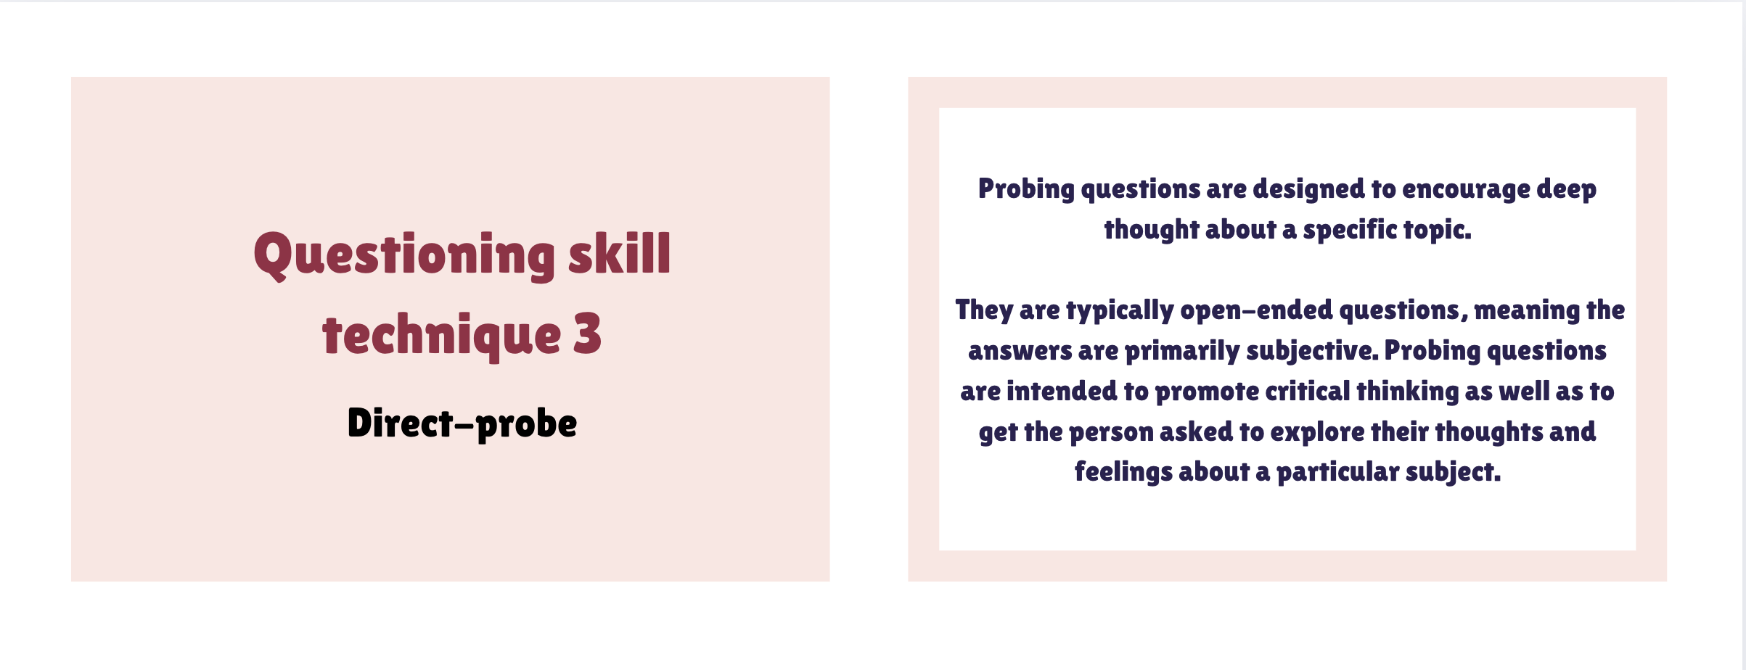
⚡ Flashcards
FIT1055: IT Professional Practice and Ethics | Week 2

Slide 30
⚡ Other questioning techniques
Objective criteria
Hypothetical
01
Questions that focus on the objective facts, to defuse any contentious situations
02
When we already know the answer but are testing the responder’s– ‘what if’ questions allow exploring options without binding the parties involved
Testing
Knowledge or skills. Softening up – these questions allow us to ‘soften up’ our audience by building rapport or flattering. Often we will already know the answer to these questions
Reflective
03
A reflective question reflects the other person’s feelings to them, giving them feedback that these feelings are acknowledged
04
FIT1055: IT Professional Practice and Ethics | Week 2

Slide 31
⚡ Feedback Techniques
It gives the recipient advice, support, or constructive criticism. It includes both positive and negative aspects.
For feedback to be constructive, it ought to be:
Fair - Accurate - Specific - Formally structured - Solution - oriented - Focused on behavior, not personality
FIT1055: IT Professional Practice and Ethics | Week 2

Slide 32
Quiz 2: Test your authentic learning in applying effective communication skills techniques
Before we begin, please do the following
1
Read through the flashcard (from listening technique to feedback) for 5-10 minutes and the accompanied notes on Moodle
2
Attempt the quiz on this link: https://quizizz.com/join?gc=63694040
FIT1055: IT Professional Practice and Ethics | Week 2

Slide 33
Part 3: Effective Professional Writing
Email · Reports · Professional Messages · The 5-Step Framework
FIT1055: IT Professional Practice and Ethics | Week 2

Slide 34
Effective Professional Writing
5-Step Approach to Professional Written Communication
Identify the objectives (am I writing to apply a job, send a proposal, seek new ideas?)
Conduct research (if it an internship job, what skills are they looking for?)
Create background (e.g., who am I, how did I come about the information? Why should they bother to read this?)
Compose a message
Follow-up
FIT1055: IT Professional Practice and Ethics | Week 2

Slide 35
General rules
Clearly state who’s writing for whom
Clarify what the document/purpose of writing is all about
Detail the information in a clear, concise and conclusive manner
Make initiatives for the readers
End the message “nicely”
How to compose message
FIT1055: IT Professional Practice and Ethics | Week 2

Slide 36
Example of professional writing in email
FIT1055: IT Professional Practice and Ethics | Week 2

Slide 37
Part 4: Oral Presentation Skills
Planning · Narrative · Delivery · Visual Aids · Minto Pyramid
FIT1055: IT Professional Practice and Ethics | Week 2

Slide 38
The four stages in developing oral presentation
Planning
Development
Writing (Narratives)
Delivery
FIT1055: IT Professional Practice and Ethics | Week 2

Slide 39
Stage 1: Planning
Presentation topic
Occasion/event and goal
Audience (size, demographic)
How will the characteristics or needs of your audience impact the content of your presentation?
Logistics (if applicable)
Room size
Available equipment
Other speakers
Time constraints
FIT1055: IT Professional Practice and Ethics | Week 2

Slide 40
Learning about the audience
Audience
Those who wanted the comm. To take place
Contents
You as the presenter
FIT1055: IT Professional Practice and Ethics | Week 2

Slide 41
Learning about the audience
Employees
Management
You as Subject Matter Expert
How much do you know?
How much does the audience know?
How much does the audience think you know?
FIT1055: IT Professional Practice and Ethics | Week 2

Slide 42
Stage 2 : Development and Writing
1. Type of presentation:
Informational
Motivational
Situational
All of the above
2. Outline the presentation, including key points for the introduction, key messages, and sequence of ideas.
3. Determine what information is needed to support your message?
Tips: Your presentation should have a clear structure, and do not forget to link them together. In such a brief allotted time, you won’t have time to do much besides summarising the main points and providing key messages you want to impart to the audience.
FIT1055: IT Professional Practice and Ethics | Week 2

Slide 43
Stage 2 : Development and Writing
4. Develop the introduction, discussion, and conclusion.
Introduction: Provide a clear introduction to the presentation. Make sure you cover the context, aim, and structure of the presentation. You may say something like this:
“We will be speaking on the article titled …, which was written by …, who specializes in the field of … as an investigative journalist. [i.e. the context] In this presentation, we will be providing you with the main highlights discussed in the article.., I will be speaking first to provide the introduction, and then X will be discussing the key messages, which will be followed by Y, who will conclude the takeaway message. [i.e. the structure]”
Conclusion: Make sure you conclude the presentation properly by covering: a summary, a key takeaway point/points, and closing remarks. This may sound like this:
“Overall, we found that the article provides an interesting insight into the industry, namely… [i.e. a takeaway point] … This concludes our presentation, and thank you very much for listening. Do you have any questions? [i.e. a closing remark]”
FIT1055: IT Professional Practice and Ethics | Week 2

Slide 44
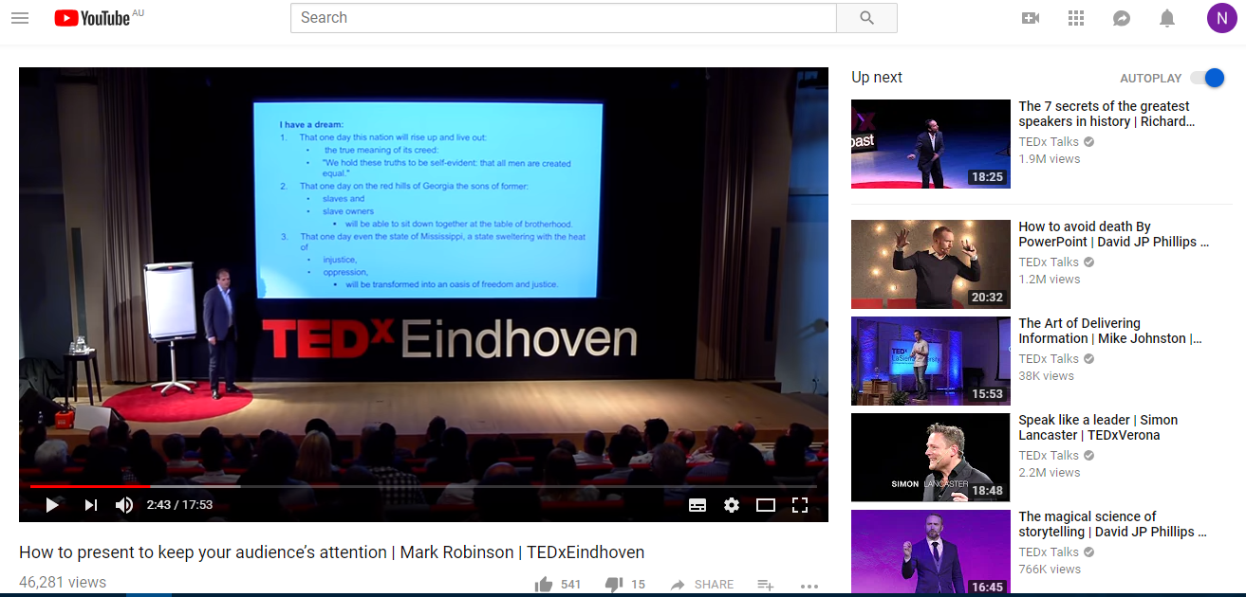
Stage 3 : Narratives
A good narrative makes the information relevant to the audience. It transforms the information into usable intelligence.
Story-telling is a good way of giving a good narrative.
FIT1055: IT Professional Practice and Ethics | Week 2

Slide 45
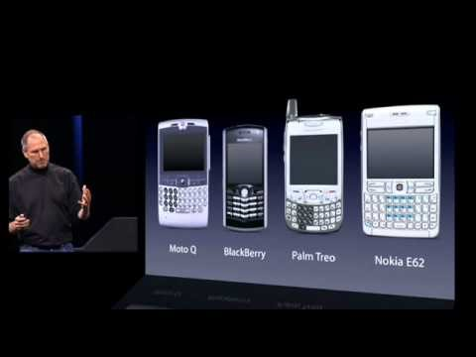
Stage 4 : Delivery Style
Presentations as performance: Who presents, matters.
FIT1055: IT Professional Practice and Ethics | Week 2

Slide 46
Delivery Tips — How You Present Matters
Amy Cuddy's TED Talk “Your Body Language May Shape Who You Are” — Key Insights:
Power postures affect confidence and how others perceive your competence
Eye contact, posture, voice projection, and pacing all communicate credibility
Practise out loud — reading silently and presenting aloud are very different skills
FIT1055: IT Professional Practice and Ethics | Week 2

Slide 47
Visual Aids & Delivery — Best Practices
The 10-20-30 Rule (Guy Kawasaki) for presentations:
10 slides — the optimal number. More than 10 slides = losing your audience.
20 minutes — maximum speaking time to maintain audience attention and energy.
30 point font — minimum size. If you need to go smaller, you have too much text on that slide.
FIT1055: IT Professional Practice and Ethics | Week 2

Slide 48
💬 Discussion Point — Know Your Audience
3 minutes — discuss with the person next to you
1
Think of a presentation you've seen. Who was the intended audience — and how could you tell?
2
As an IT professional presenting to non-technical management — what would you change about your language and structure?
3
What is the difference between an informational and a motivational presentation? When would you use each?
FIT1055: IT Professional Practice and Ethics | Week 2

Slide 49
Part 5 : Minto Pyramid Principle
Visual Aids techniques to engage your audience
FIT1055: IT Professional Practice and Ethics | Week 2

Slide 50
🔺 The Minto Pyramid Principle
Start with your conclusion — then support it with evidence (top-down structure)
1
Situation → Complication → Question → Answer (SCQA) — the backbone of structured communication
2
See “Sample slides using Minto Principle” on Week 2 Moodle under Resources
3
Used widely in consulting — directly applicable to your Assignment 2 group presentation (10%)
FIT1055: IT Professional Practice and Ethics | Week 2

Slide 51
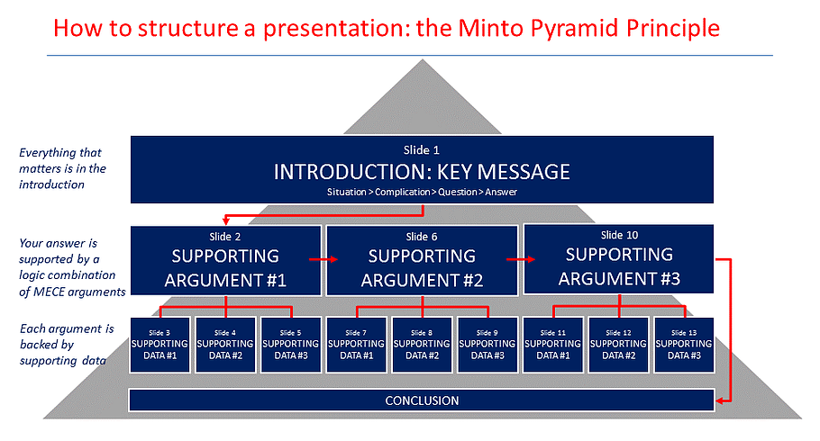
🔺 How to structure a presentation: The Minto Pyramid Principle
(PowerUser, 2016; based on Minto, 2009)
FIT1055: IT Professional Practice and Ethics | Week 2

Slide 52
Quiz 3: Minto Pyramid Principle Application
Before we begin, please do the following
1
First review the sample slide on Minto Pyramid Principle on Moodle Week 2 page, located under “Resources”.
2
Spend 10 minutes to go through
2
Attempt the quiz on this link: https://quizizz.com/join?gc=30926040
What does this quiz assess?
Your ability to identify the structure in a real-world presentation
Your understanding of top-down communication — answer first, then evidence
FIT1055: IT Professional Practice and Ethics | Week 2

Slide 53

One of the greatest talks
Watch and gather some insights to understand what made this one of the top TEDTalks?
Link: The power of Grit
FIT1055: IT Professional Practice and Ethics | Week 2

Slide 54
Attend your Applied Session — you will work in groups and practise your first group oral presentation
Review the "Sample Slides Using the Minto Pyramid Principle" under Resources on Week 2 Moodle
Understand the expectations for your Assignment 2b group oral presentation
Things To Do This Week 📌
Attend your Applied Session — you will work in groups and practise your first group oral presentation
Review the "Sample Slides Using the Minto Pyramid Principle" under Resources on Week 2 Moodle
Understand the expectations for your Assignment 2b group oral presentation
Make sure you complete all of the following before next week's session:
Attend your Applied Session — you will work in groups and practise your first group oral presentation
Review the "Sample Slides Using the Minto Pyramid Principle" under Resources on Week 2 Moodle
Understand the expectations for your Assignment 2b group oral presentation
FIT1055: IT Professional Practice and Ethics | Week 2

Slide 55
Summary — What You Covered in Week 2
✓
Theory of Communication
Speech Act Theory (Austin & Searle) · Common Ground (Clark) · Grounding in conversation
✓
Professional Communication Skills
Intrapersonal vs Interpersonal · Assertiveness · Active Listening · Questioning · Feedback
✓
Effective Writing
5-Step approach · Composing clear messages · Professional email conventions
✓
Oral Presentation Skills
Planning · Narrative · Delivery · Visual Aids · The 10-20-30 Rule
✓
Minto Pyramid Principle
The structure · Top-down communication · Direct application to Assignment 2
FIT1055: IT Professional Practice and Ethics | Week 2

